Slide 1
Principles of Leadership
Decision Making
Spring 2023
Fareed Qureshi
“The risk of a wrong decision is preferable to the terror of indecision.”
– Maimonides

Slide 2
TODAY’S AGENDA POINTS
Characteristics of Managerial Decisions
Lack of structure
Uncertainty and risk
Conflict
The Stages of Decision Making
Identifying and diagnosing the problem
Generating alternative solutions
Evaluating alternatives
Making the choice
Implementing the decision
Evaluating the decision
The best decision
Barriers to Effective Decision Making
Psychological biases
Time pressures
Social realities

Slide 3


Slide 4

The business executive is by profession a decision maker. Uncertainty is his opponent. Overcoming it is his mission.
-- John McDonalds

Slide 5
CHARACTERISTICS OF MANAGERIAL DECISIONS

Slide 6
LACK OF STRUCTURE
Programmed decisions
Nonprogrammed decisions

Slide 7

UNCERTAINTY AND RISK
Certainty
Uncertainty
Risk
Managing the risk
Calculated risks

Slide 8
CONFLICT
Psychological conflict
Interpersonal/inter-group conflict

Slide 9

THE STAGES OF DECISION MAKING
Identify and diagnose a problem
1
Generate alternative solutions
2
Evaluate alternatives
3
Make the choice
4
Implement the decision, and
5
Evaluate the decision
6

Slide 10
IDENTIFY AND DIAGNOSE A PROBLEM
Recognize
Discrepancy between the current state and a desired state
Comparing current performance against (1) past performance, (2) current performance of other organizations or units, or (3) future expected performance as determined by plans and forecasts
A problem maybe an opportunity – understanding of your company’s macro- and competitive environments
Recognize → diagnose
The “WHY”
Is there a difference between what is happening and what should be happening ?
How can you describe the deviation, as specifically as possible ?
What is/are the causes of the deviation ?
What specific goals should be met ?
Which of these goals are critical to the success of the decision ?

Slide 11
“I never know what to work on. My boss sends me stuff to do at random times, and I’m not sure what’s most important. When he walks over to my desk, I’m afraid he’ll interrupt what I’m doing to have me work on something totally different.”
“I need to be able to prioritize what I’m working on at any given time.”

Slide 12
GENERATING ALTERNATIVE SOLUTIONS
Links problem diagnosis to the development of alternative courses of action
Ready-made solutions
Custom-made solutions
Asking for help
An expert → subject matter expert, a trusted confidant
The rationale behind the decisions

Slide 13

EVALUATE THE ALTERNATIVES
Which solution will be the best ?
Predict the consequences of all options – lower costs, higher sales, lower employee turnover, and higher profits.
Is our information about alternatives complete and current ?
Does the alternative meet our primary objective?
What problem could we have if we implement the alternative?

Slide 14
MAKING THE CHOICE
Paralysis by analysis
Maximizing – achieving the best possible outcome
Satisficing – choosing the first option that is minimally acceptable or adequate
Optimizing – achieving the best possible balance among several goals.

Slide 15
IMPLEMENT THE DECISION
Determine how things will look when the decision is fully operational
Chronologically order the steps necessary to achieve a fully operational decision
List the resources and activities required to implement each step
Estimate the time needed for each step
Assign responsibility for each step to specific individuals
Identify potential problems and identify potential opportunities

Slide 16
EVALUATE THE DECISION
Positive feedback – decision is working and can also be applied elsewhere
Negative feedback – either (1) implementation will require more time, resources, effort or thought, or (2) the decision was a bad one

Slide 17
WHAT IS A GOOD DECISION ?
A good decision is one that is made deliberately and thoughtfully, considers and includes all relevant factors, is consistent with the individual’s philosophy and values, and can be explained clearly to significant others.

Slide 18
BARRIERS TO EFFECTIVE DECISION MAKING
Psychological Biases
Time Pressures
Social Realities

Slide 19
Psychological Biases
Objectivity vs. Subjectivity
Discounting the future
Confirmation bias
Framing bias
Hindsight bias ~ “IKIAA”
Anchoring
Halo ~ Horn effect
Overconfidence bias
Status-quo bias
Pro-innovation bias
Bandwagon bias

Slide 20
TIME PRESSURES
The “speed trap” can be as dangerous as moving too slowly.
“trap of being all-knowing”
Real-time information
Involve people more effectively and efficiently
Take a realistic view of conflict
Situation

Slide 21
SOCIAL REALITIES
Accountability
Many decisions are the result of intensive social interactions, bargaining, and politicking

Slide 22
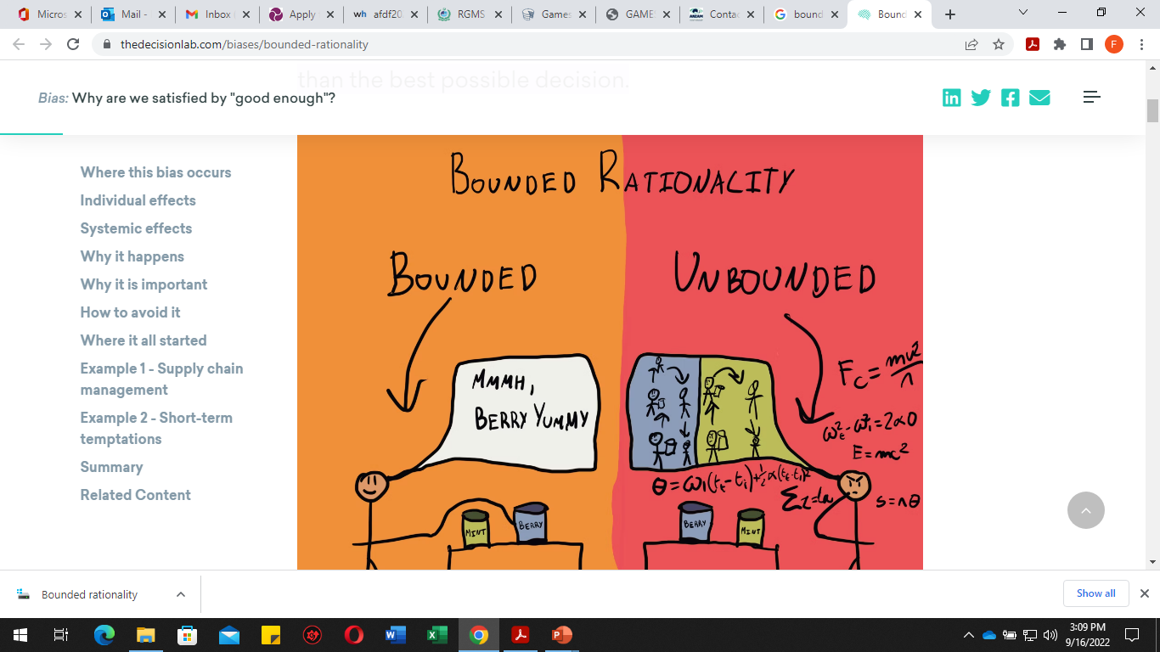
BOUNDED RATIONALITY

Slide 23
THAT’S ALL FOR TODAY!!

